Slide 1
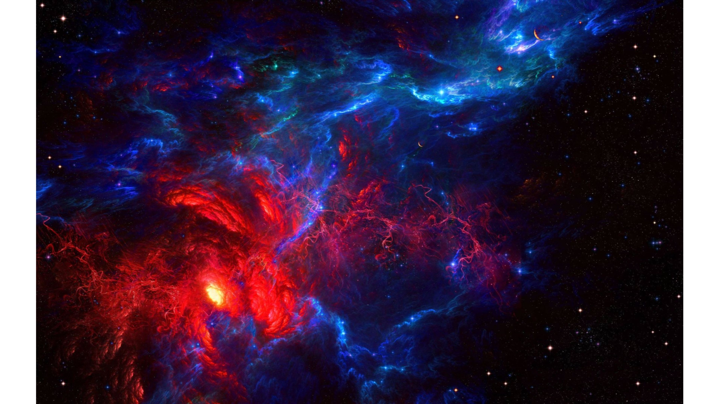
SPACE
SH00TER
Їптѳ тнё ЇЙFЇЙЇTЧ

Slide 2
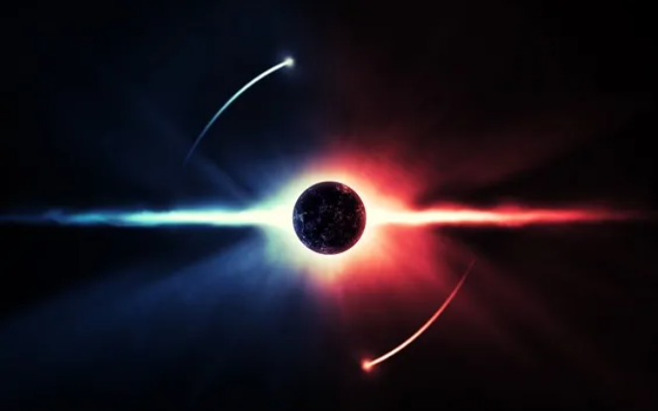
Problem STATEMENT
𝙳𝚎𝚟𝚎𝚕𝚘𝚙𝚖𝚎𝚗𝚝 𝚘𝚏 𝚊 𝚐𝚊𝚖𝚎 𝚠𝚒𝚝𝚑 𝚊 𝚂𝚙𝚊𝚌𝚎𝚆𝚊𝚛
𝚃𝚑𝚎𝚖𝚎 𝚞𝚜𝚒𝚗𝚐 𝙿𝚢𝚝𝚑𝚘𝚗 𝚊𝚗𝚍 𝙿𝚢𝚐𝚊𝚖𝚎.
ᴍᴀᴅᴇ ʙʏ:-
𝟷)ʏᴀsʜᴏᴡᴀʀᴅʜᴀɴ sʜɪɴᴅᴇ
𝟸)ʏᴀsʜ ᴘᴀɴᴄʜᴠᴀᴛᴋᴀʀ
𝟹)sᴜᴍɪᴛ ᴘᴀᴛɪʟ

Slide 3
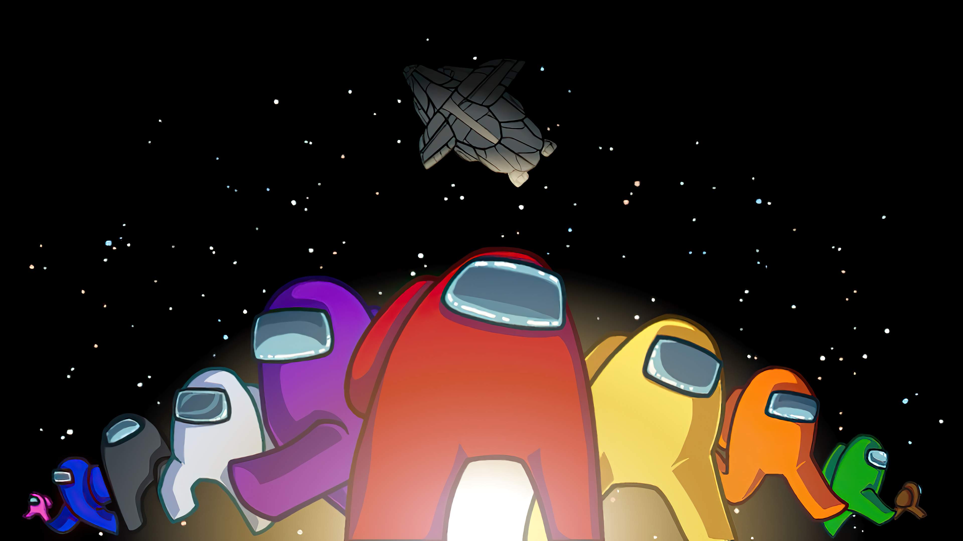
METHoD0LoGY:
ᴜsᴇᴅ ᴀ ᴘʏᴛʜᴏɴ ᴘᴀᴄᴋᴀɢᴇ ᴄᴀʟʟᴇᴅ ᴘʏɢᴀᴍᴇ. ɪᴛ ɪs sᴘᴇᴄɪᴀʟʟʏ ᴅᴇsɪɢɴᴇᴅ ғᴏʀ ᴅᴇᴠᴇʟᴏᴘɪɴɢ ɢᴀᴍᴇs ɪɴ ᴘʏᴛʜᴏɴ. ᴜsɪɴɢ ᴛʜɪs ᴘᴀᴄᴋᴀɢᴇ ᴡᴇ ᴍᴀɴᴀɢᴇᴅ ᴛᴏ ᴅᴇᴠᴇʟᴏᴘ ᴏᴜʀ sᴘᴀᴄᴇ ᴡᴀʀ ᴛʜᴇᴍᴇᴅ ɢᴀᴍᴇ ᴡʜɪᴄʜ ᴡᴇ ɴᴀᴍᴇᴅ sᴘᴀᴄᴇ sʜᴏᴏᴛᴇʀ. ʀᴇғᴇʀᴇɴᴄᴇs ᴡᴇʀᴇ ᴛᴀᴋᴇɴ ғʀᴏᴍ ʏᴏᴜᴛᴜʙᴇ ᴠɪᴅᴇᴏs ᴀɴᴅ ᴘʏɢᴀᴍᴇ ᴅᴏᴄᴜᴍᴇɴᴛᴀᴛɪᴏɴ. ᴡᴇ ᴜsᴇᴅ ᴠᴀʀɪᴏᴜs ғᴜɴᴄᴛɪᴏɴs ᴀᴠᴀɪʟᴀʙʟᴇ ɪɴ ᴛʜᴇ ᴘʏɢᴀᴍᴇ ᴍᴏᴅᴜʟᴇ ᴡʜɪᴄʜ ʜᴇʟᴘᴇᴅ ᴜs ᴡɪᴛʜ ᴛʜᴇ ɢʀᴀᴘʜɪᴄs ᴘᴀʀᴛ ᴏғ ᴛʜᴇ ᴘʀᴏᴊᴇᴄᴛ. ᴀᴛ ᴛʜᴇ ᴇɴᴅ ᴡᴇ ʜᴀᴠᴇ ᴍᴀɴᴀɢᴇᴅ ᴛᴏ ᴅᴇᴠᴇʟᴏᴘ ᴀ ɢᴀᴍᴇ ᴡʜɪᴄʜ ɪs sᴜᴘᴇʀ ғᴜɴ ᴀɴᴅ ᴠᴇʀʏ ᴇᴀsʏ ᴛᴏ ᴘʟᴀʏ.

Slide 4
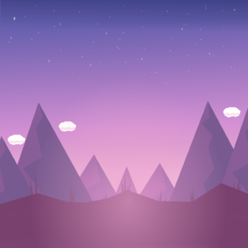







Brief overview

Slide 5
